Slide 1

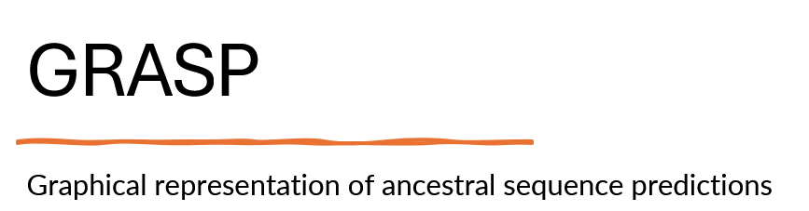
Isabella Kögl Hannah Fuchsbrugger MOL.981 UF
03.06.24

Slide 2
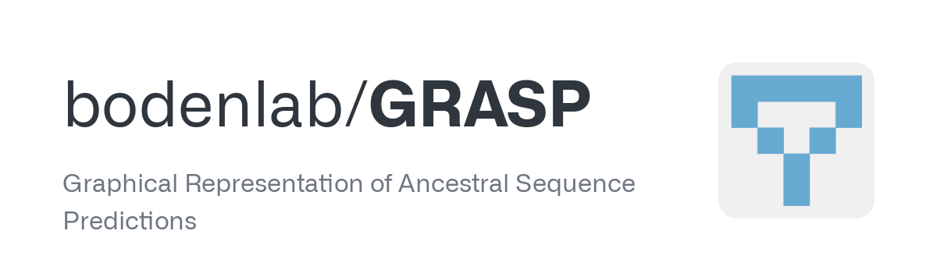
Ancestral sequence reconstruction
Select extant sequences
Create a multiple sequence alignment
Compute phylogenetic tree
Reconstruct ancestral sequences
1
2
3
4
Merkl, Rainer and Sterner, Reinhard. "Ancestral protein reconstruction: techniques and applications" Biological Chemistry, vol. 397, no. 1, 2016, pp. 1-21. https://doi.org/10.1515/hsz-2015-0158

Slide 3
Ancestral sequence reconstruction
common ancestor
Horizontal comparison
Variations observed for one specific point in time
PTGVS
Multiple sequence alignments allows for identification of conserved key amino acids
Vertical
evolutionary history
→ Residues that historically led to a new function can often not be identified by comparing extant sequences
PSGVS
PTGVS
RPWDW
Vertical comparison
RINDW
Ancestral sequence reconstruction
Includes the internal nodes of the tree and considers the chronology of mutations
Horizontal
comparison of extant sequences
Sorts out neutral and epistatic mutations
Identification of key functional residues, construction of ancestors with novel properties, protein engineering using ancestral templates and understanding evolutionary history
Gabriel Foley, University of Queensland . "Engineering indel and substitution variants of diverse and ancient enzymes using GRASP”. https://www.youtube.com/watch?v=vlwdbPFr2kU&t=2559s

Slide 4
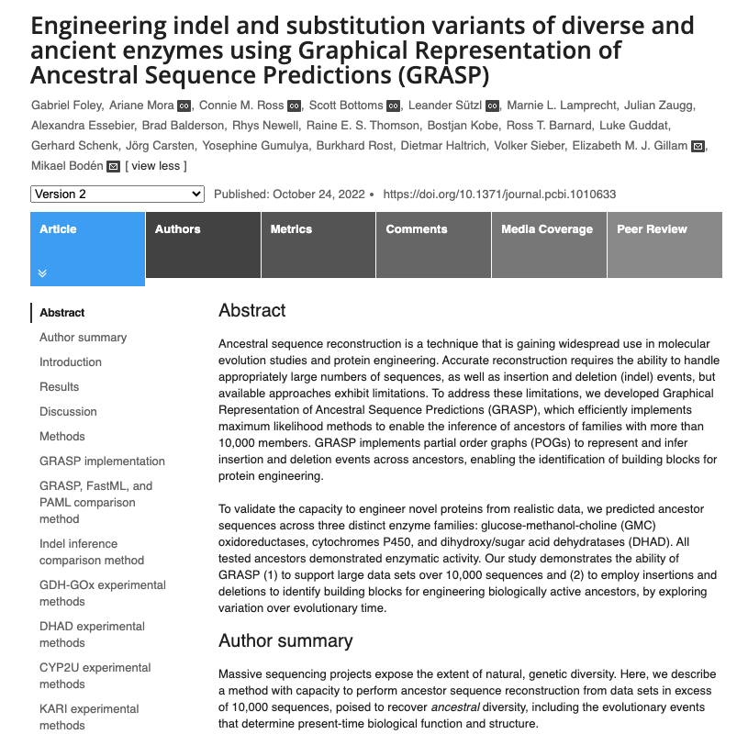
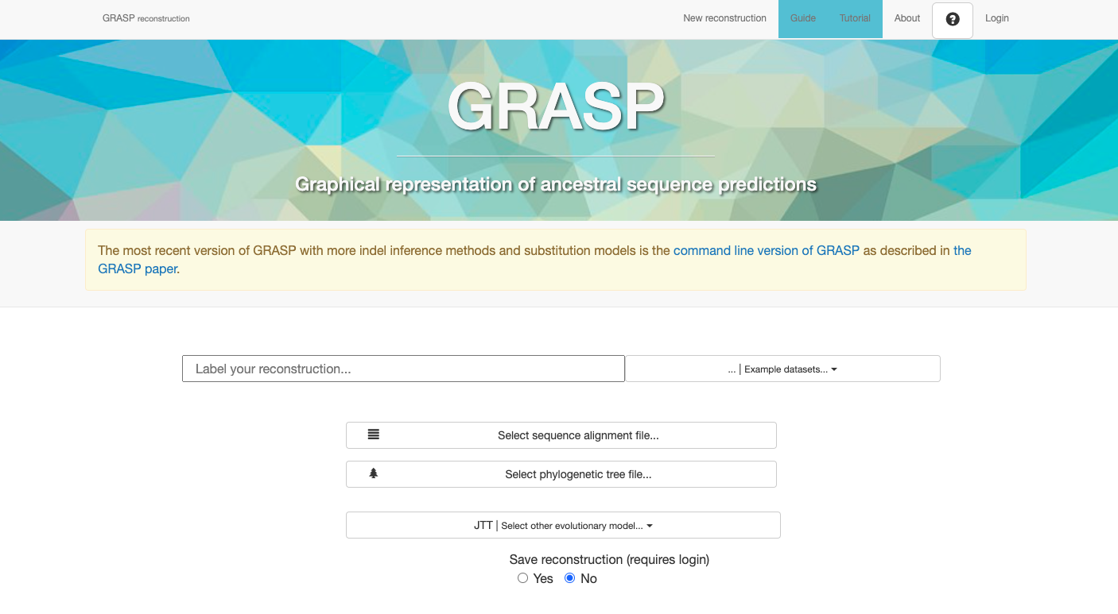
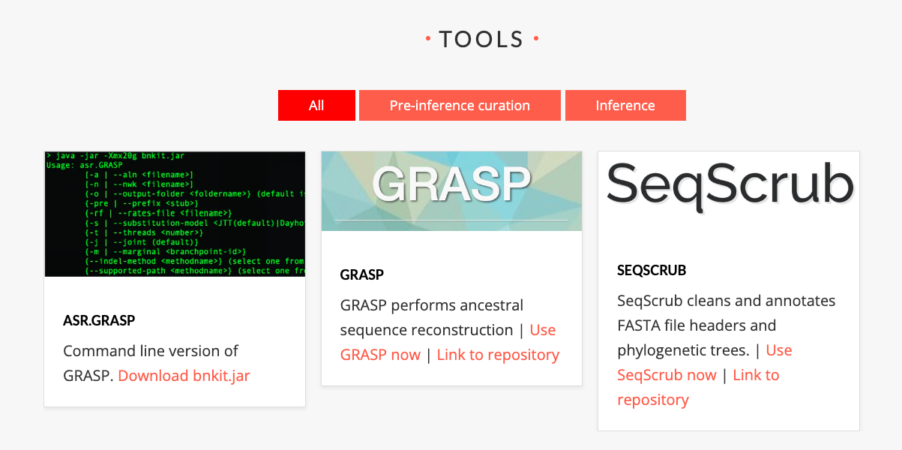
GRASP Graphical representation of ancestral sequence predictions
Tool for performing ancestral sequence reconstructions
→ infers ancestral proteins from homologous protein sequences
Complex and large data sets
→ able to process large numbers of sequences (more than 10,000)
Novel strategy for suggesting “insertion-deletion variants” that are distinct from, but can be explored alongside, substitution variants for creating ancestral libraries

Slide 5
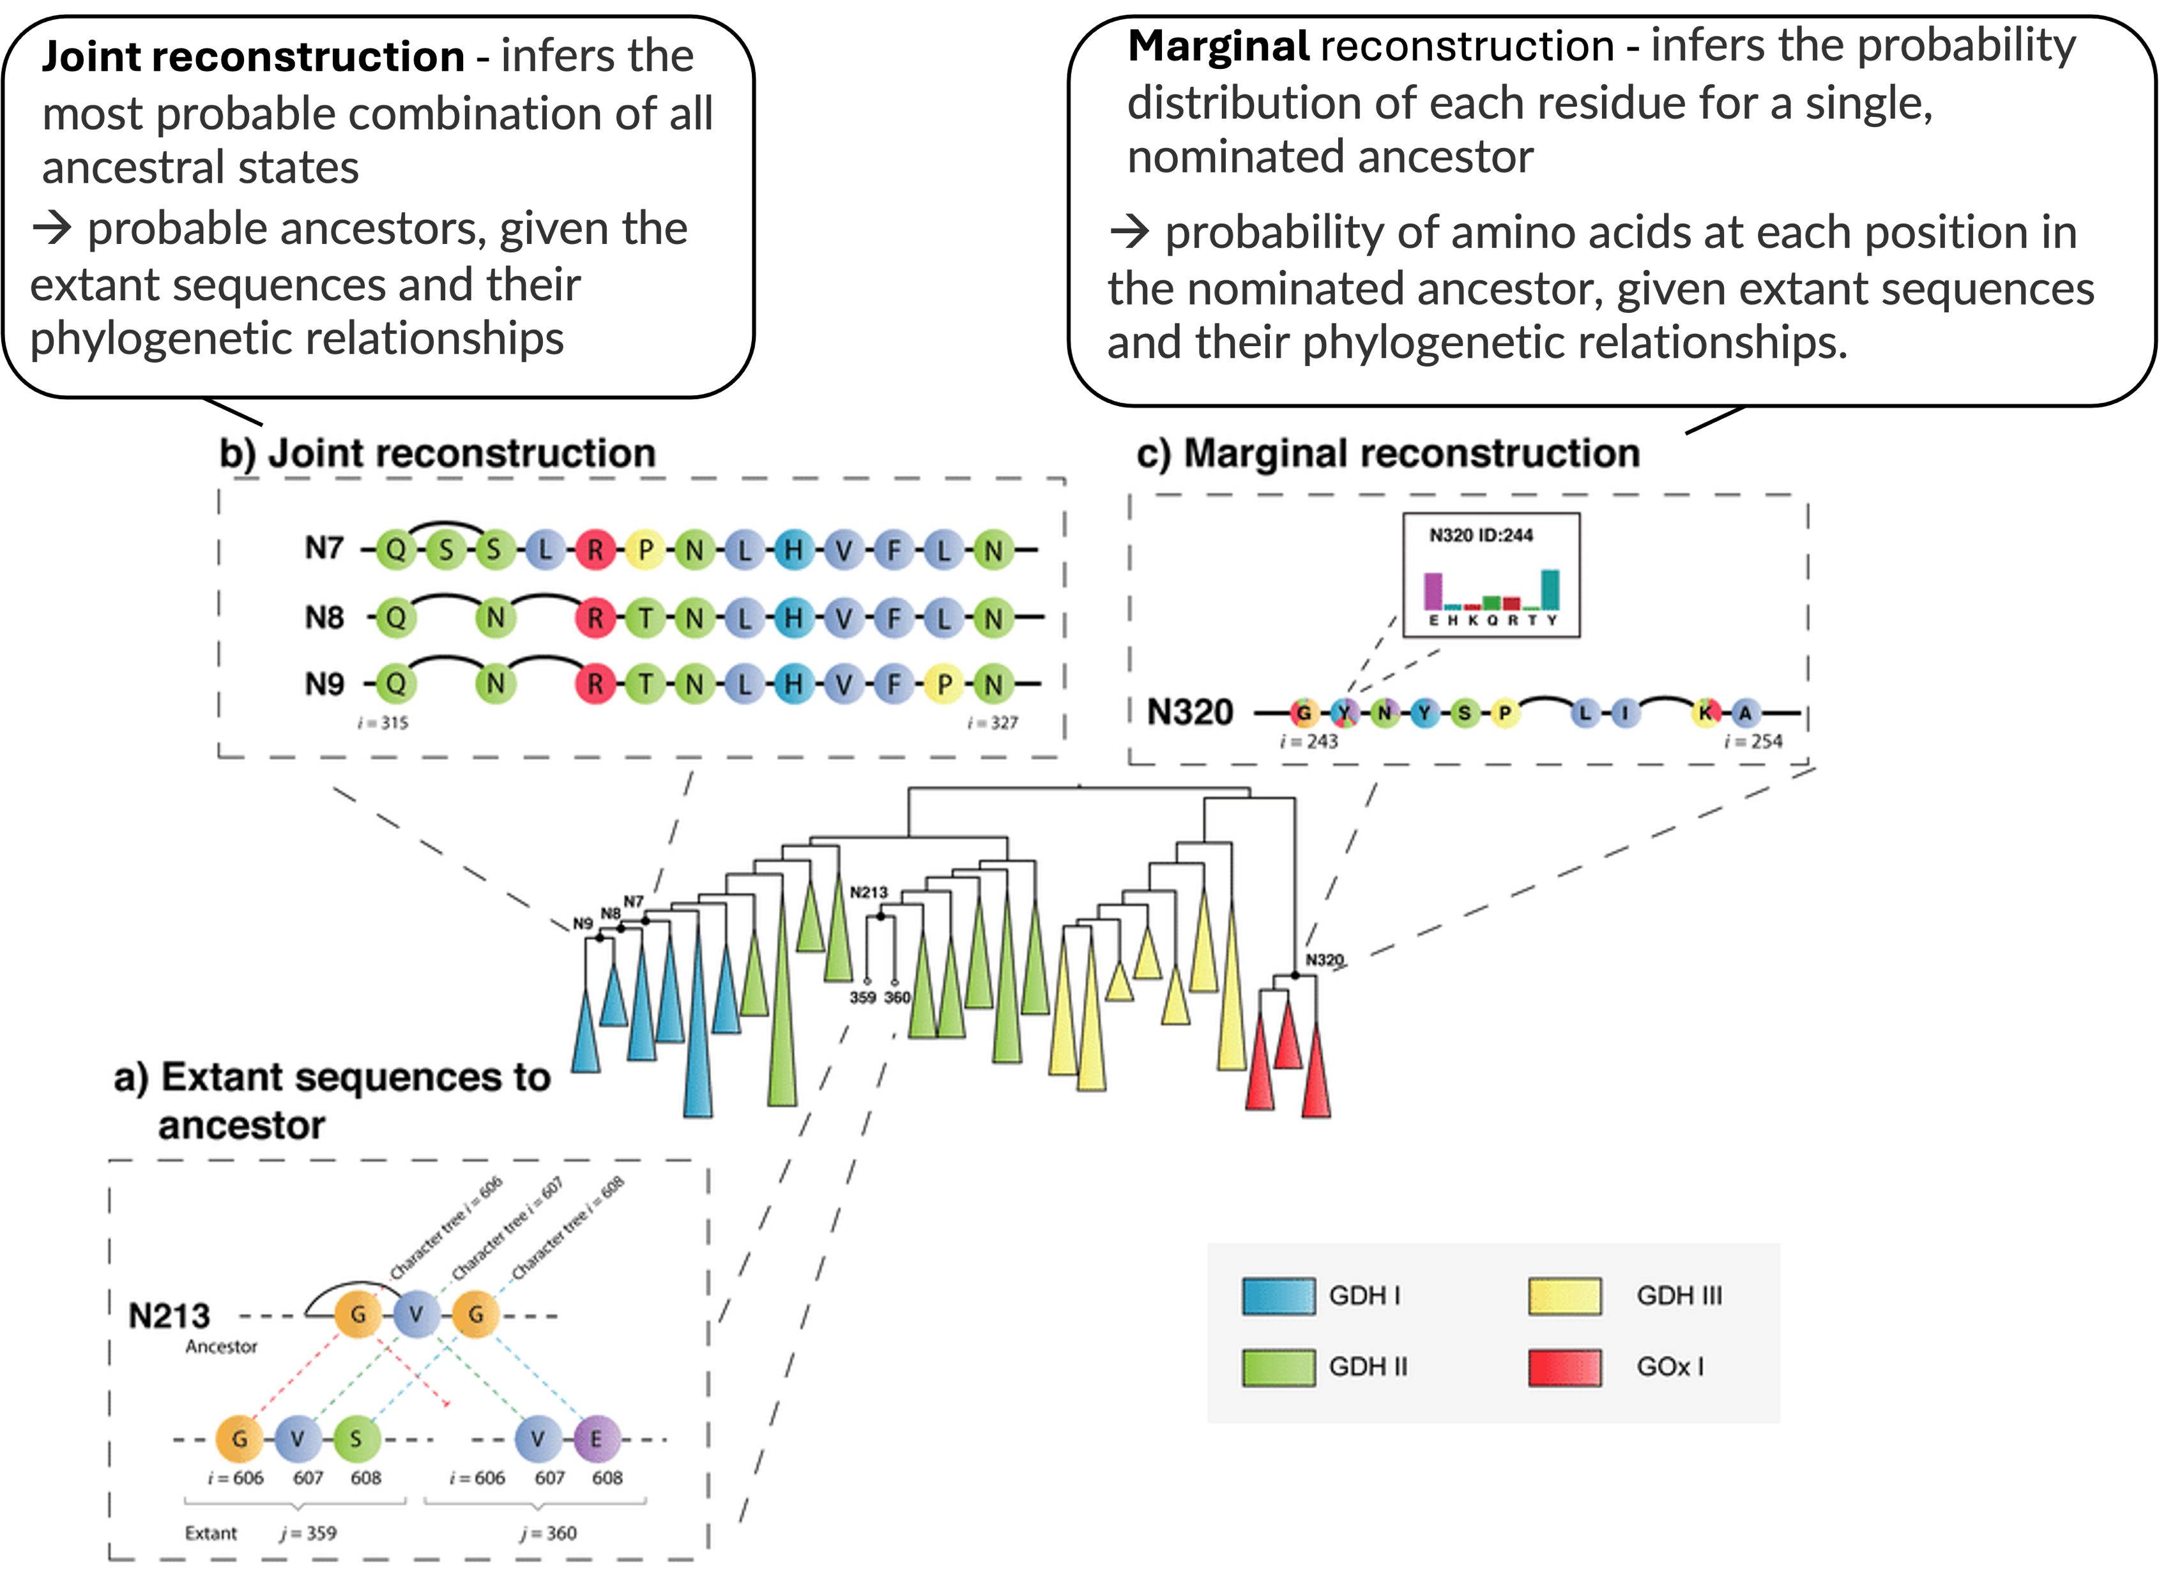
GRASP: steps in ancestral sequence reconstruction
1) Construct an indel (insertion and deletion) history for every position in the alignment by either maximum likelihood or maximum parsimony
2) Infer character states for each ancestor
3) Form a POG for each ancestor by linking all inferred character states and optionally suggesting one path to generate a single sequence

Slide 6
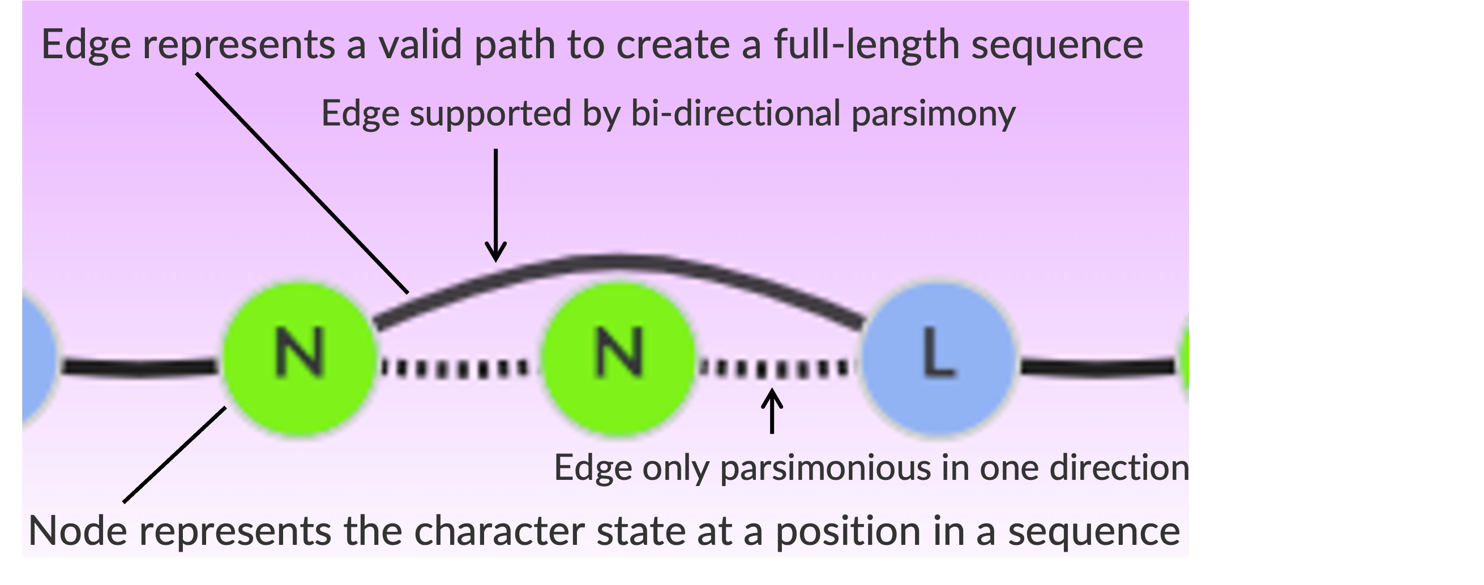
Partial order graphs
GRASP uses POGs (partial order graphs) to represent ancestors
Represents variability in ancestors in terms of the potential insertions and deletions events
inference and visualization of indel events across ancestors
representation of candidate ancestors as alternative paths through an ancestor POG
Represent deletions and insertions by edges that exclude or include alternative character subsets allowing for optional histories by offering multiple paths at ancestral branch points
The darker the edge, the more extant sequences (of the set in the subtree under the ancestor) travel through the same edge
Gabriel Foley, University of Queensland . "Engineering indel and substitution variants of diverse and ancient enzymes using GRASP”. https://www.youtube.com/watch?v=vlwdbPFr2kU&t=2559s

Slide 7
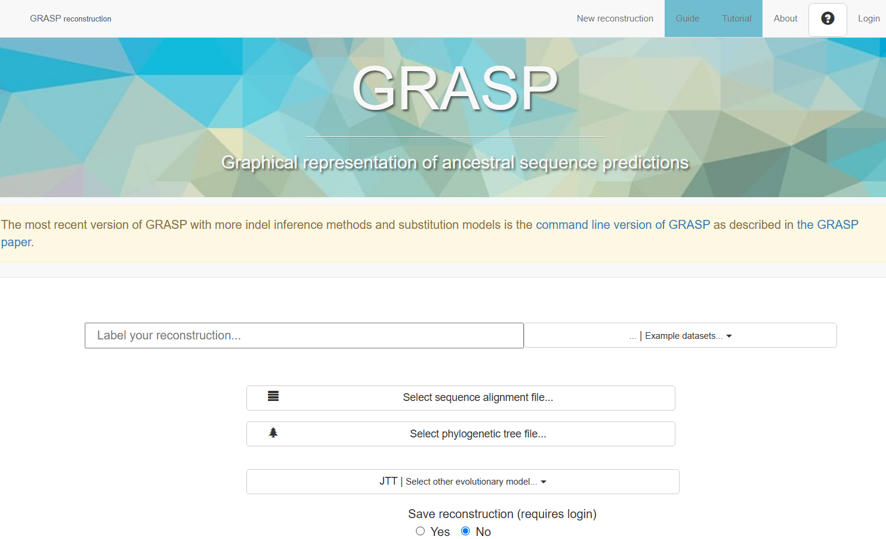
Web version

Slide 8
Input data
Aligned sequences
File formats: FASTA, Clustal
MSA tools to create alignment file: T-Coffee, MAFFT, MUSCLE,..
Corresponding phylogenetic tree
File format: Newick
Tools to create phylogenetic tree file: FastTree, MEGA, MrBayes,..
Alignment and phylogenetic tree must have the exact same identifier names

Slide 9
Output
Phylogenetic tree
→ Interactive version of the provided tree
→ Expand or collapse subtrees
→ Option to trigger new reconstruction within the tree
Partial order graphs (POGs) connected to phylogenetic tree
→ To represent and infer substitutions, insertions and deletions across ancestors
→ Ancestors can be „stacked“ so changes can be viewed
http://grasp.scmb.uq.edu.au/

Slide 10
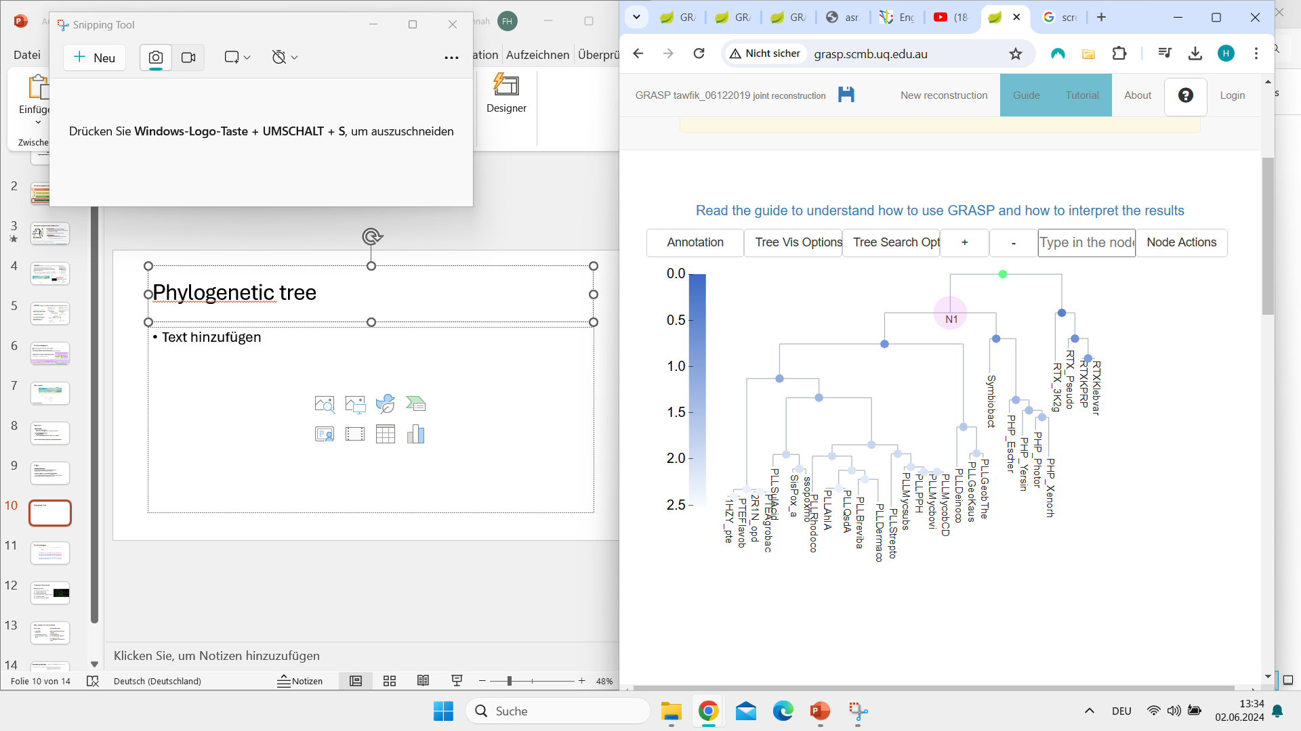
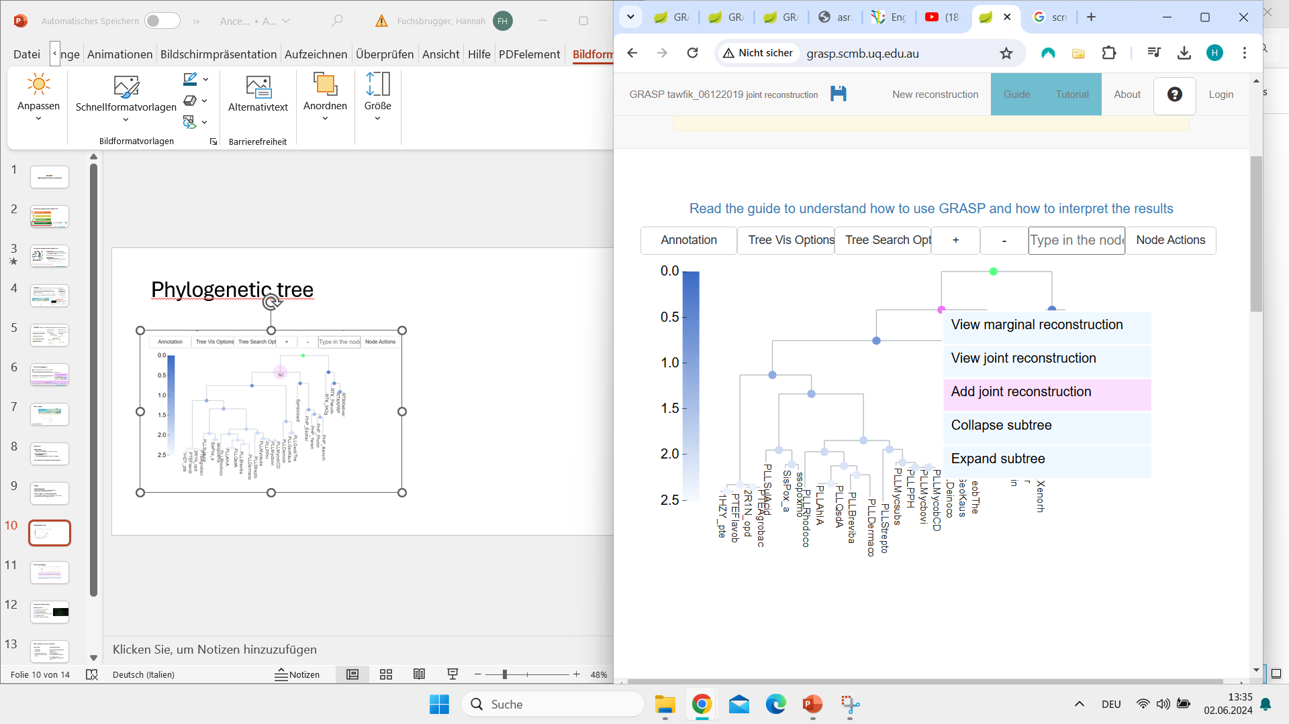
Phylogenetic tree

Slide 11
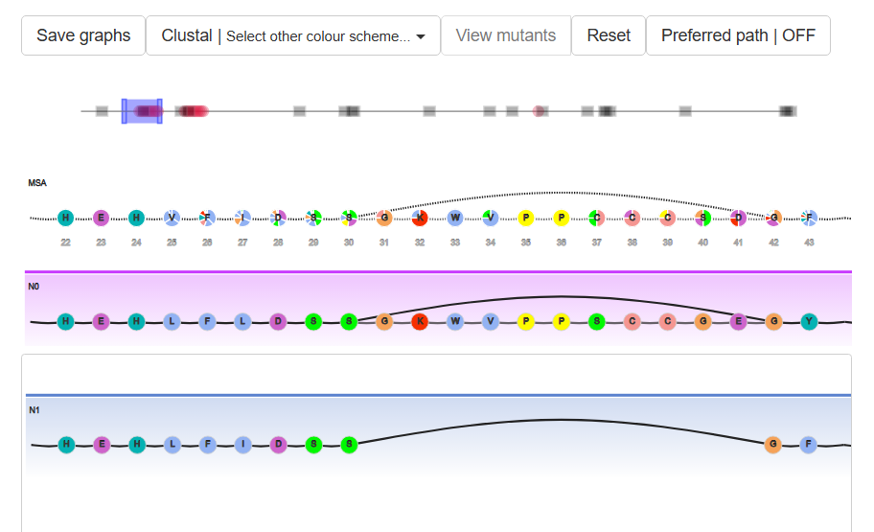
Partial order graph – N0 and N1 stacked
①
②
③
④
① Navigation bar
② POG for input sequences
③ POG for primary ancestor N0
④ POG for ancestor N1
Deletion in N1

Slide 12
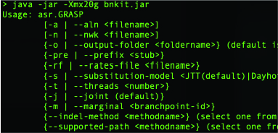
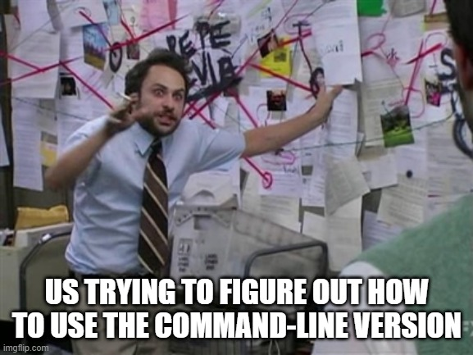
Command-line version
How do you run it?
Update Java to newest version
Download bnkit JAR file
Create a bash script file
Load input data, run analysis
Install Graphviz
Visualize results with Graphviz

Slide 13


Web version vs command line
Web version
User friendly
Visualization
Only for protein sequences
You have to register for some actions
Command-line version
Run reconstructions on your own hardware
Usually quicker
Useful for large files
For protein and DNA sequences
No graphical interface
A lot of things to download/install/ create

Slide 14
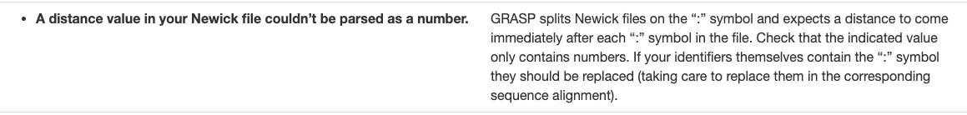
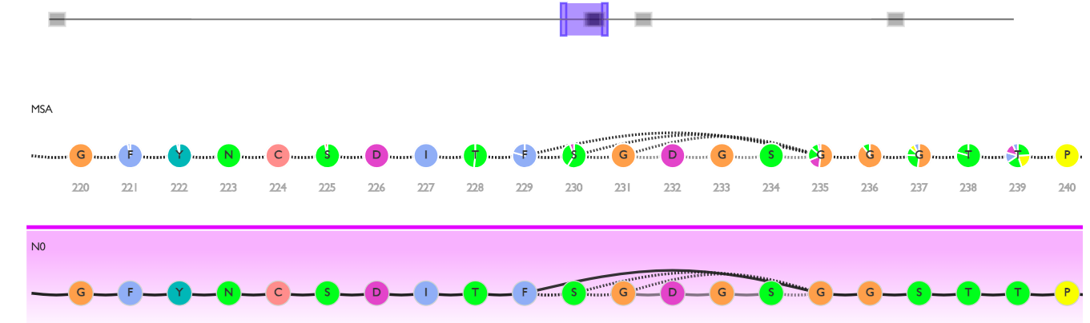
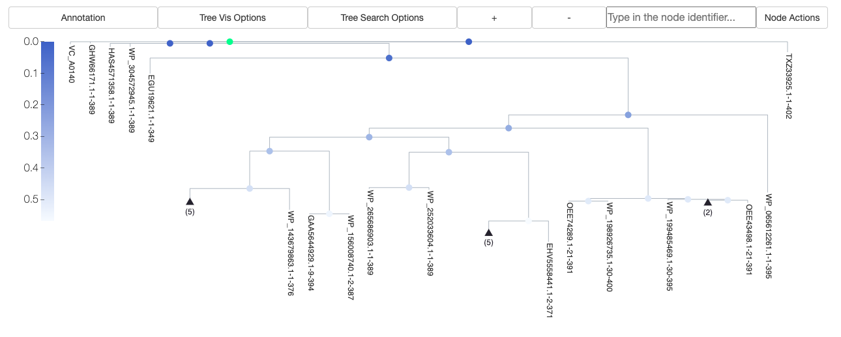
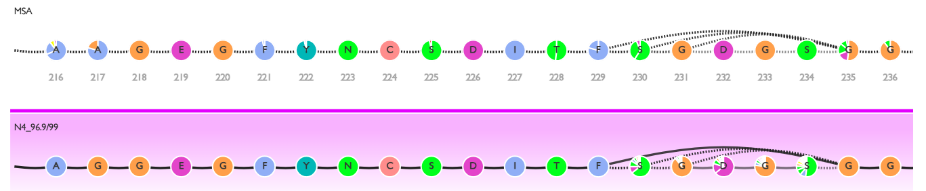
Trial with course data
MAFFT_aa_LPMO.FASTA → IQ-Tree for phylogenetic tree
Error!

